Slide 1
L.Q: To understand the importance of the Eightfold path to a Buddhist.

Slide 2
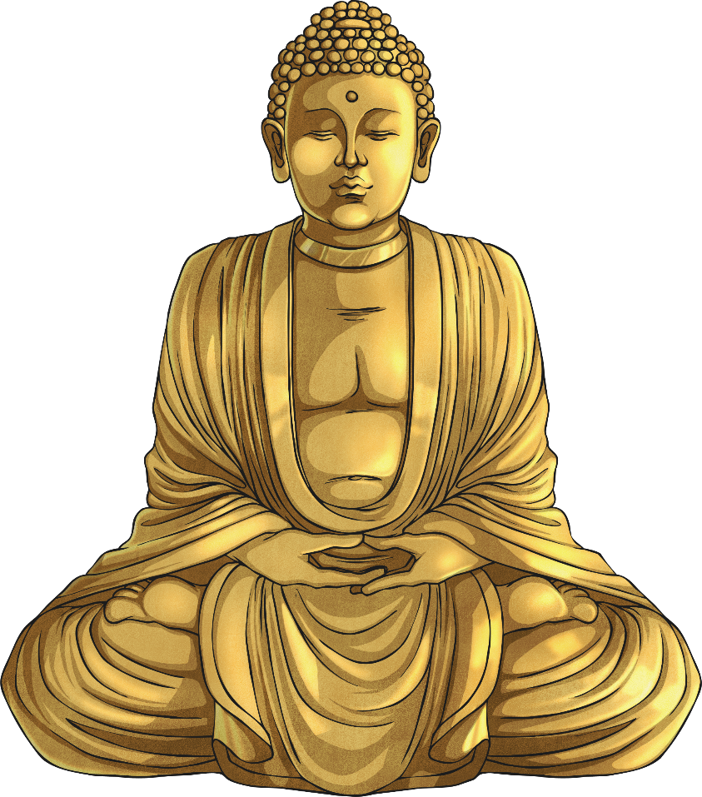
What is the Eightfold Path?
Blind faith is when a person accepts something without really thinking it through for themselves.
The Eightfold Path consists of eight areas of life that people focus on towards the path of Buddhism. They can be worked on in any order and some are more difficult to achieve than others depending on the situation or the person.
It is designed to relieve suffering.
Buddhism works on promoting learning and self discovery rather than ‘blind faith’.

Slide 3
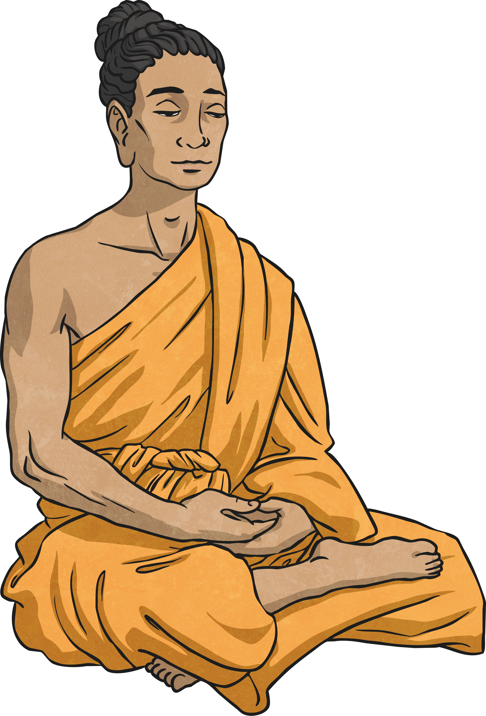
Right Understanding
Having right understanding is when you see the world as it really is and not how you want it to be. Sometimes we try to change things that are outside of our control and we can get upset or not understand things clearly.
Think of a time when you have been upset because you have misunderstood a situation and something seems out of your control. You wanted it to be different to how it really was.

Slide 4
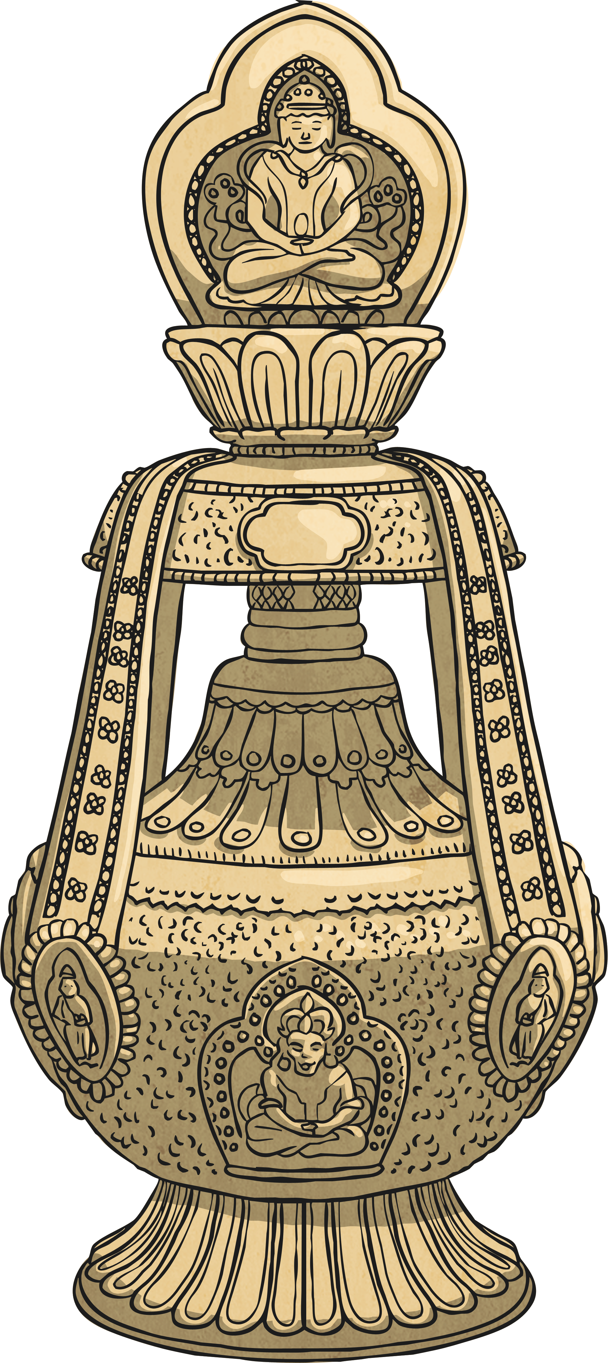
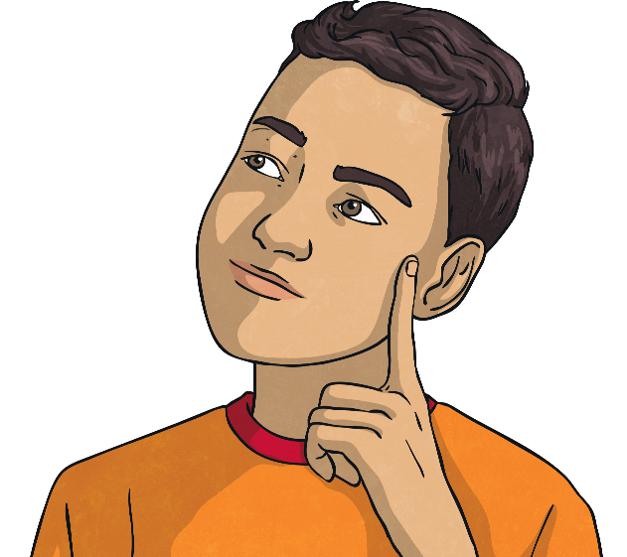
Right Speech
Think of a time when you might not have had the right reasons for a decision. What were you trying to gain?
Right Intent means we can commit to a decision or action for the right reasons, once we understand things properly by looking at what is really there and not what we want it to be like.
We need to ask ourselves if we are just being selfish, or are we thinking of others with care and compassion?

Slide 5
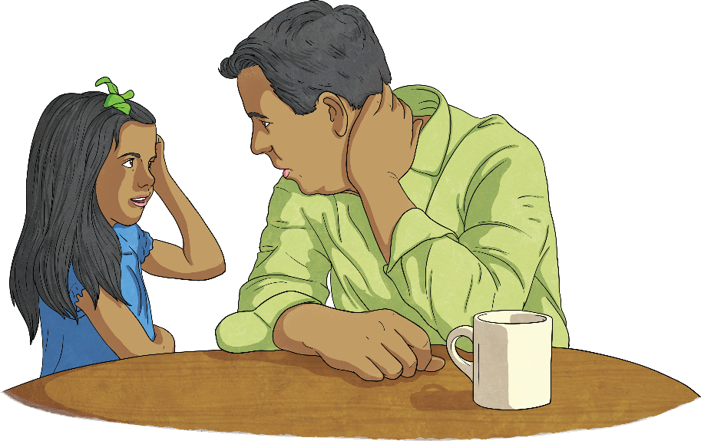
Right Speech
Often things we say in anger or gossip behind people’s backs can cause upset and hurt, and take a long time to sort out. Having Right Speech is deciding never to speak unkindly or in anger.
Have you hurt someone’s feelings by something you have said to them or about them?
Reflect on a time you could have said something differently or not at all.

Slide 6
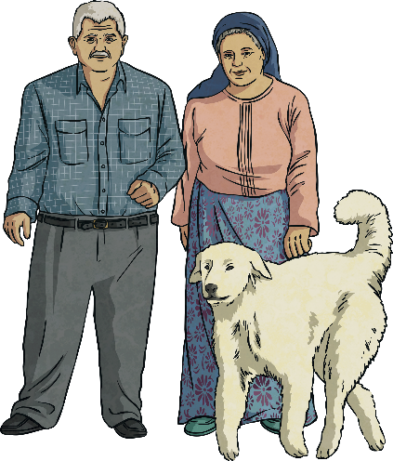
Right Action
Right action means behaving in a thoughtful way, considering others and the world we live in. Through our actions, it is a chance to keep the world safe for future generations to live in.
Has there been a time that you have done something that has affected someone else?

Slide 7
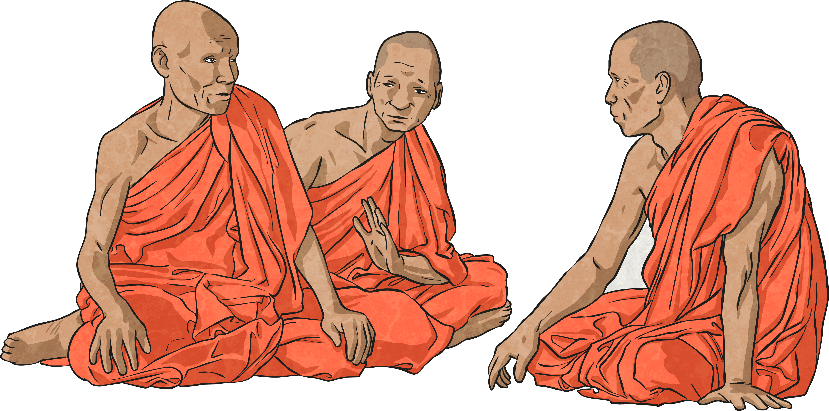
Right Livelihood
Our livelihood, how we choose to work and earn money, can have an effect on the world at large. Buddhists do not agree that people should work in a job that might cause harm to others. They would not agree with being a gun seller, butcher or any job that involved harming animals. They believe that we should work for the good of the community and benefit the world as a whole.
What job would you like to do in the future? Is it something that will help someone or will it harm them?

Slide 8
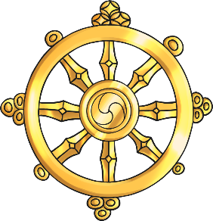
Right Effort
Sometimes we put a lot of effort into the wrong things. Like wanting to be the best, the prettiest or the wealthiest. Right Effort is concerned with developing a positive attitude and cheerful determination in a balanced way. This involves putting effort in to avoid feelings like greed and jealousy, and the right effort into developing feelings of compassion and consideration of others.
Think of something you put a lot of effort into. Is it worthy? Are you encouraging the right sort of feelings and skills?
Are you developing negative feelings with the effort you are putting in?

Slide 9
Right Mindfulness
Sometimes we are caught in a moment that takes our breath away, or we get so completely focused on something, we do not notice what is going on around us.
This is an awareness of a moment and our actions in that moment. We suddenly notice old habits that have controlled us and can focus on changing ourselves.
Think about the times you have been completely involved in an activity or moment. Did you suddenly see yourself differently? Did you like what you saw?

Slide 10
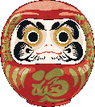
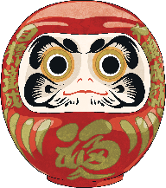
Right Concentration
Concentrating is sometimes hard because we allow ourselves to get distracted. The Eightfold Path step of Right Concentration encourages us to focus the mind on something so completely, we see it as it really is and not how we have always thought it is, or been told to see it. This action frees us from being controlled and leads us towards freedom.
Have you managed to concentrate on something so much that you suddenly had a ‘Eureka’ moment and realised something important?

